Slide 1
Website proposal
for
Fly to the limit
www.flytothelimit .co.nz
by
Mehak Arora
Client Address:
1 Victoria Street
Auckland Central
Auckland
P:09 3411846
M: 0219811121

Slide 2
Contents
Table of Contents:
Introduction
My Profile
Project Overview
Market Analysis
Target Customers
Competitors
Competitor Website Analysis
Design Analysis
Color Pallet & Font Selection
Design brainstorming
Sitemap
Final Website Design
Web Design
Project Proposal
Development Plan

Slide 3


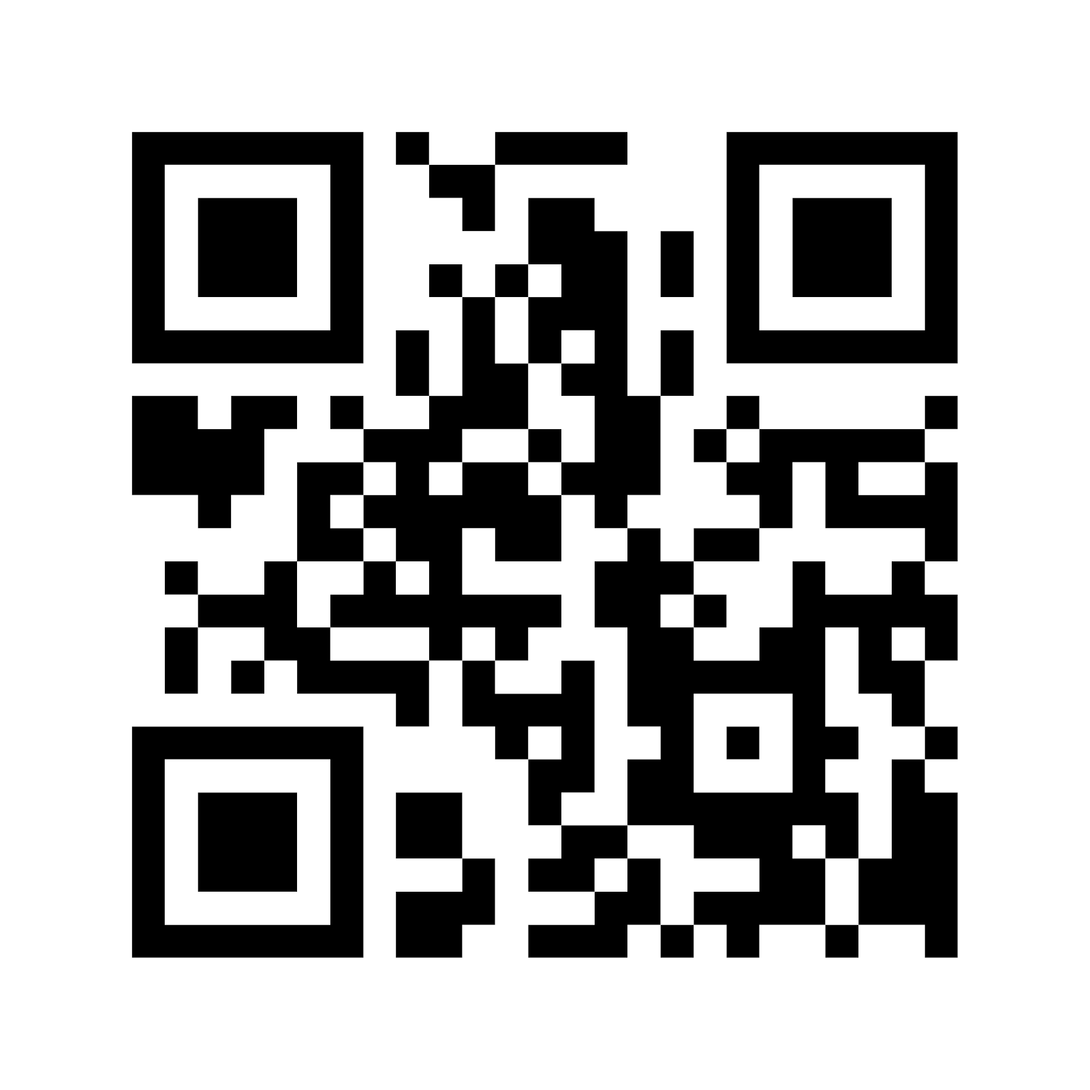



My Profile
“ I am a web development professional based in Auckland. I specialize in making responsive designs of website , database driven websites and mobile applications . I have seven years of web development Experience with a strong technical and commercial exposure of managing and delivering end to end web projects.”
Mehak Arora
(Web Development Professional)
Contact me:
PROJECT COMMITMENT
5 Kingsland, Auckland
021-98116767
me@mwebie.co.nz
TIME | SCOPE | BUDGET

Slide 4
Project Overview
Business Overview:
Brief:
This Project Requires a website to be developed for Fly To The Limit. The website would play a vital role in the business. This website proposal aims to present design and functionality that will provide effective online marketing and branding for Fly To The Limit in the New Zealand Market.
Fly To The Limit is owned by a Husband and wife team, Olga and Bruce Mckzenzie . FTTL is a small start airline offering adventure flights, transport and sight seeing in the scenic capital of New Zealand.
Operating out of Queenstown and Wanaka, FTTL offers tourist a range of scenic flights in both fixed wing and helicopters, as well as high adventure in a stunt plane, or the most peaceful flight experience possible in a glider high above the mountains .FTTL specialize in one off charters , and delivery and pick up for Trampers ,also providing a provisioning service for fresh supplies during long excursions
The business is at the higher end of the market, people who want a one off extreme experience in the most beautiful region on earth, Adrenaline pumping aerobatics ,peaceful gliding through the mountains ,flying into remote lakes, tramping/climbing expeditions ,custom sight seeing by the hour, day or week
Requirements Overview
Website must be able to accept bookings.
Website should have a Photo Gallery and You Tube videos available if possible
Website design should be targeted to high end of the market facilitating easy navigation and Contact information .

Slide 5

Market Analysis
www.flytothelimit.co.nz

Slide 6
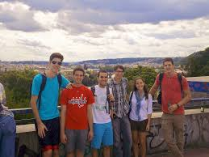
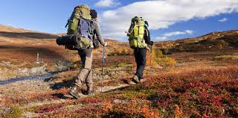
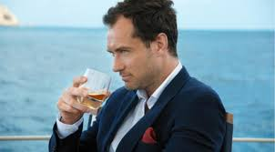

Target Customers
Target Consumers
University Student
Nature Lovers
Hiker and climbers
High end Income Group

Slide 7
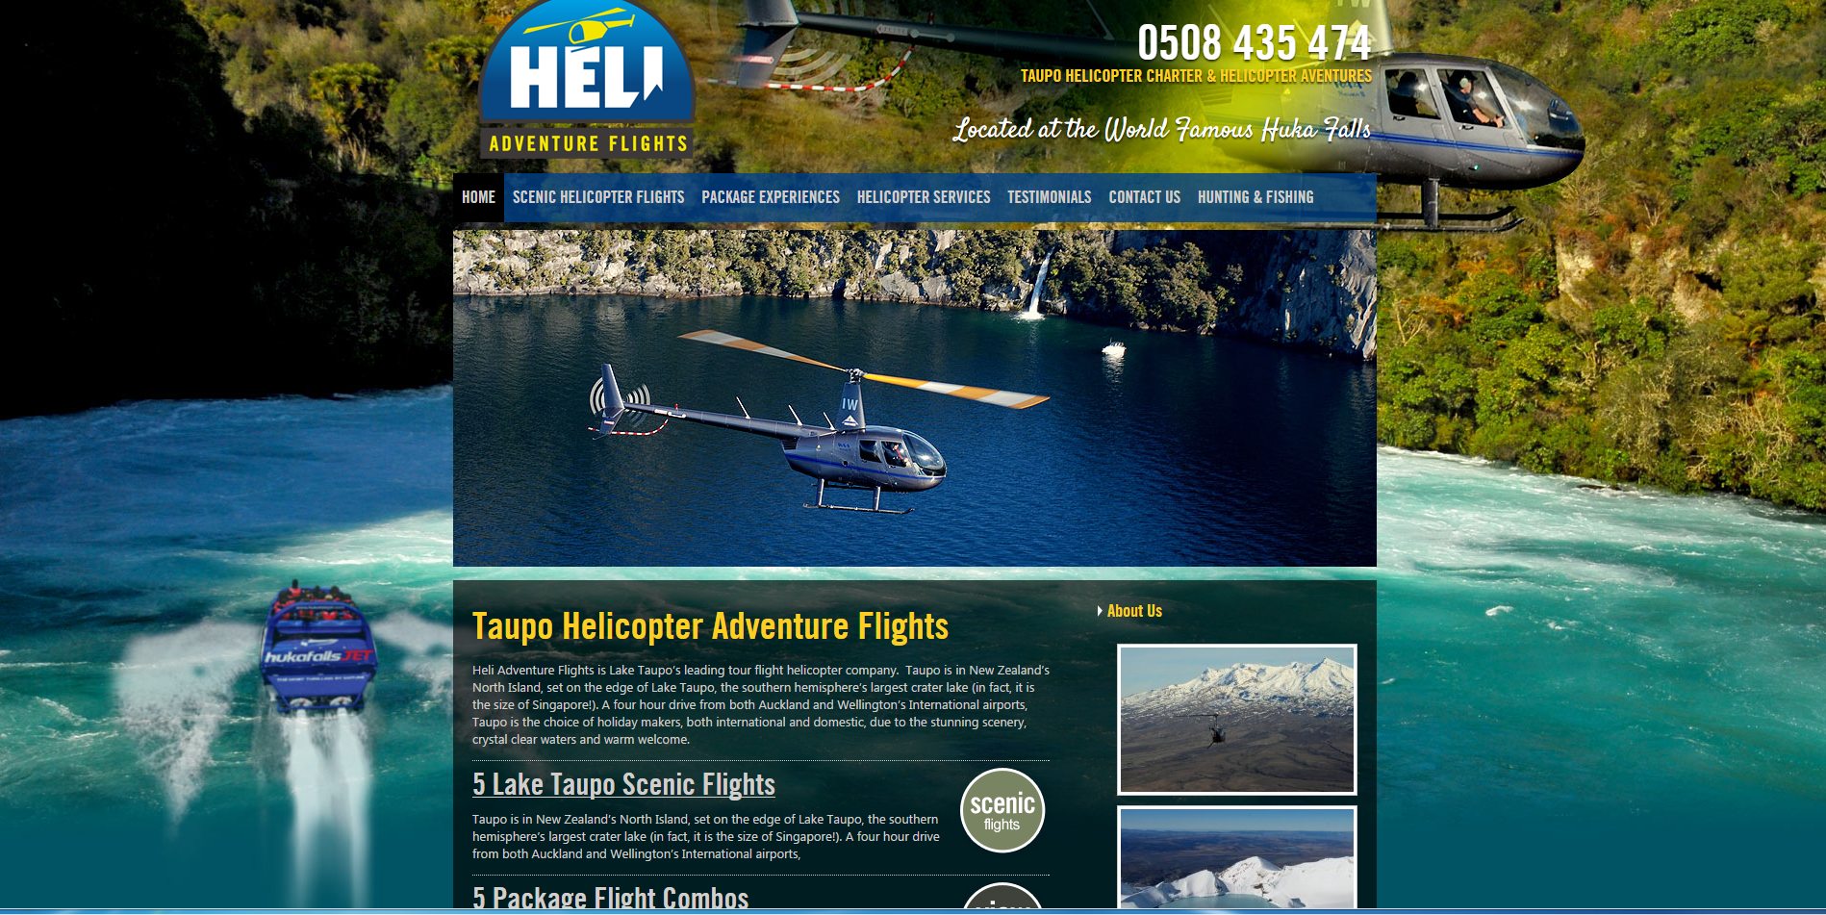

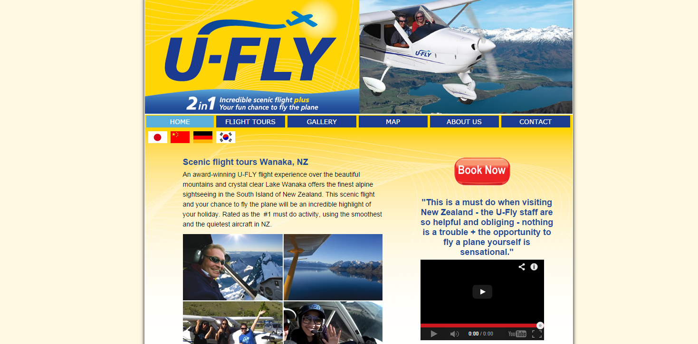
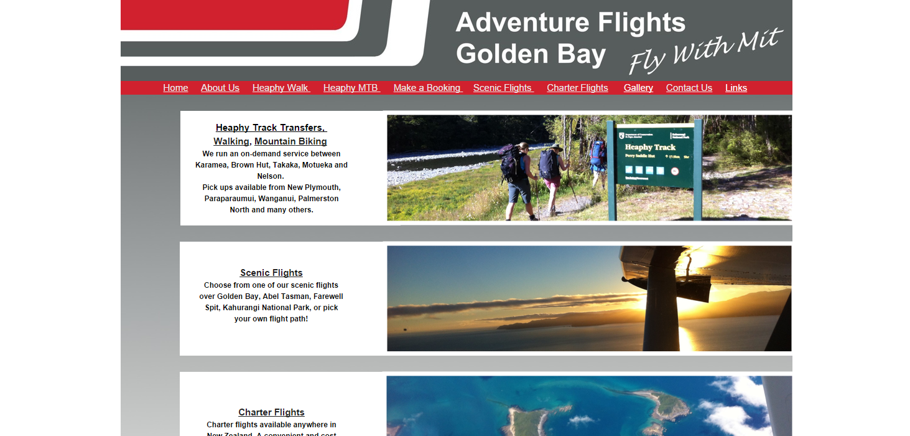
Competitors
Competitors:
This analysis presents an assessment of the strengths and weaknesses of three competitor Websites. Also, It will help in understanding the overall performance and usability requirements of the proposed website.
1
www.helicoptertours.co.nz
2
www. u-flywanaka.co.nz
3
www. adventureflightsgoldenbay.co.nz

Slide 8
Competitor Website Analysis
Competitor Analysis:
 |  |  |  | Proposed Design
 | Competition
Features | Heli Adventure Flight | U-fly | Adventure Flight Golden bay | Fly To The Limit | Description
Newsletter Subscription Sign-up | X | X | X | Yes | Newsletter subscription via email
Google map for location | X | X | X | Yes | Google map integration with direction function
Photo gallery and flight information | Yes | Yes | Yes | Yes | Separate Product Page
Contact Us Form | Yes | Yes | Yes | Yes | Separate Page with address locations
Online Booking Form | X | X | X | Yes | User will register and email order using a form.
Home page Slider | X | X | X | Yes | Photo slider provided on the home page
Staff profile page | X | X | X | Yes | Meet the team and Staff information

Slide 9
Design Analysis
www.flytothelimit.co.nz

Slide 10
Color Pallet & Font Selection
Selected Colors:
Font Selection:
Site Background –White
Font Style:
ARIAL (for all site content)
Header & Footer Background - White
Font Size Range:
10 - 26
Main Menu Background - White
Page Body Background – Light Grey
Arial has been selected since this style
Represents Simplicity and gives a formal look
Widely accepted in the corporates globally
Easy to read
Menu Button Background – Light Grey
Clicked Menu Button Background - Blue
Font Color Selection:
These colors have been shortlisted because they:
Match the Business theme
Blend with the base natural colors of sky and flying .
Main Menu Font Color – Black
Specials/ Links Font Color – Blue
Page Font Color - Black
Banner/Footer Font Color - Blue

Slide 11
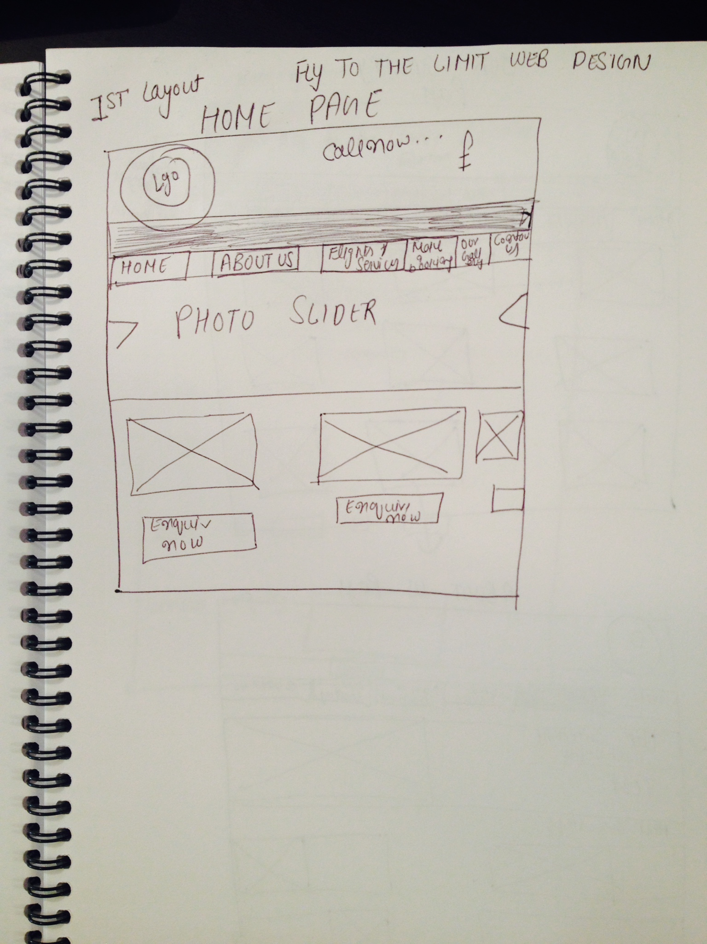
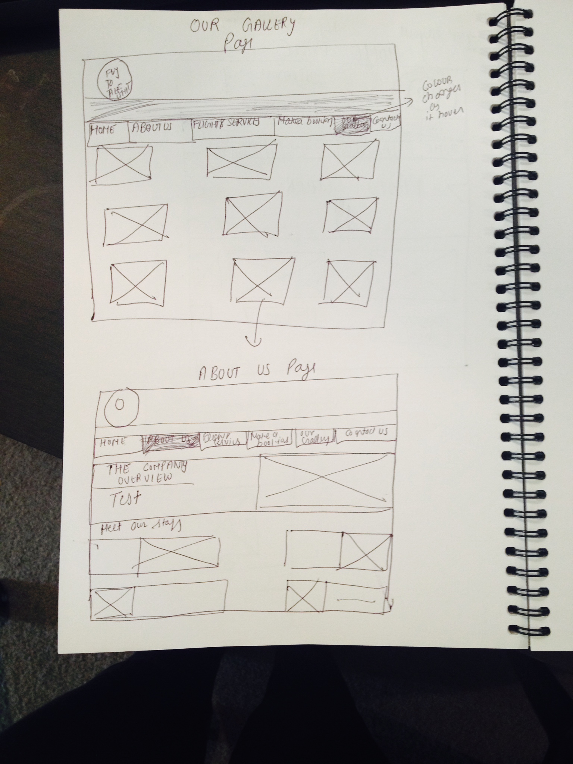
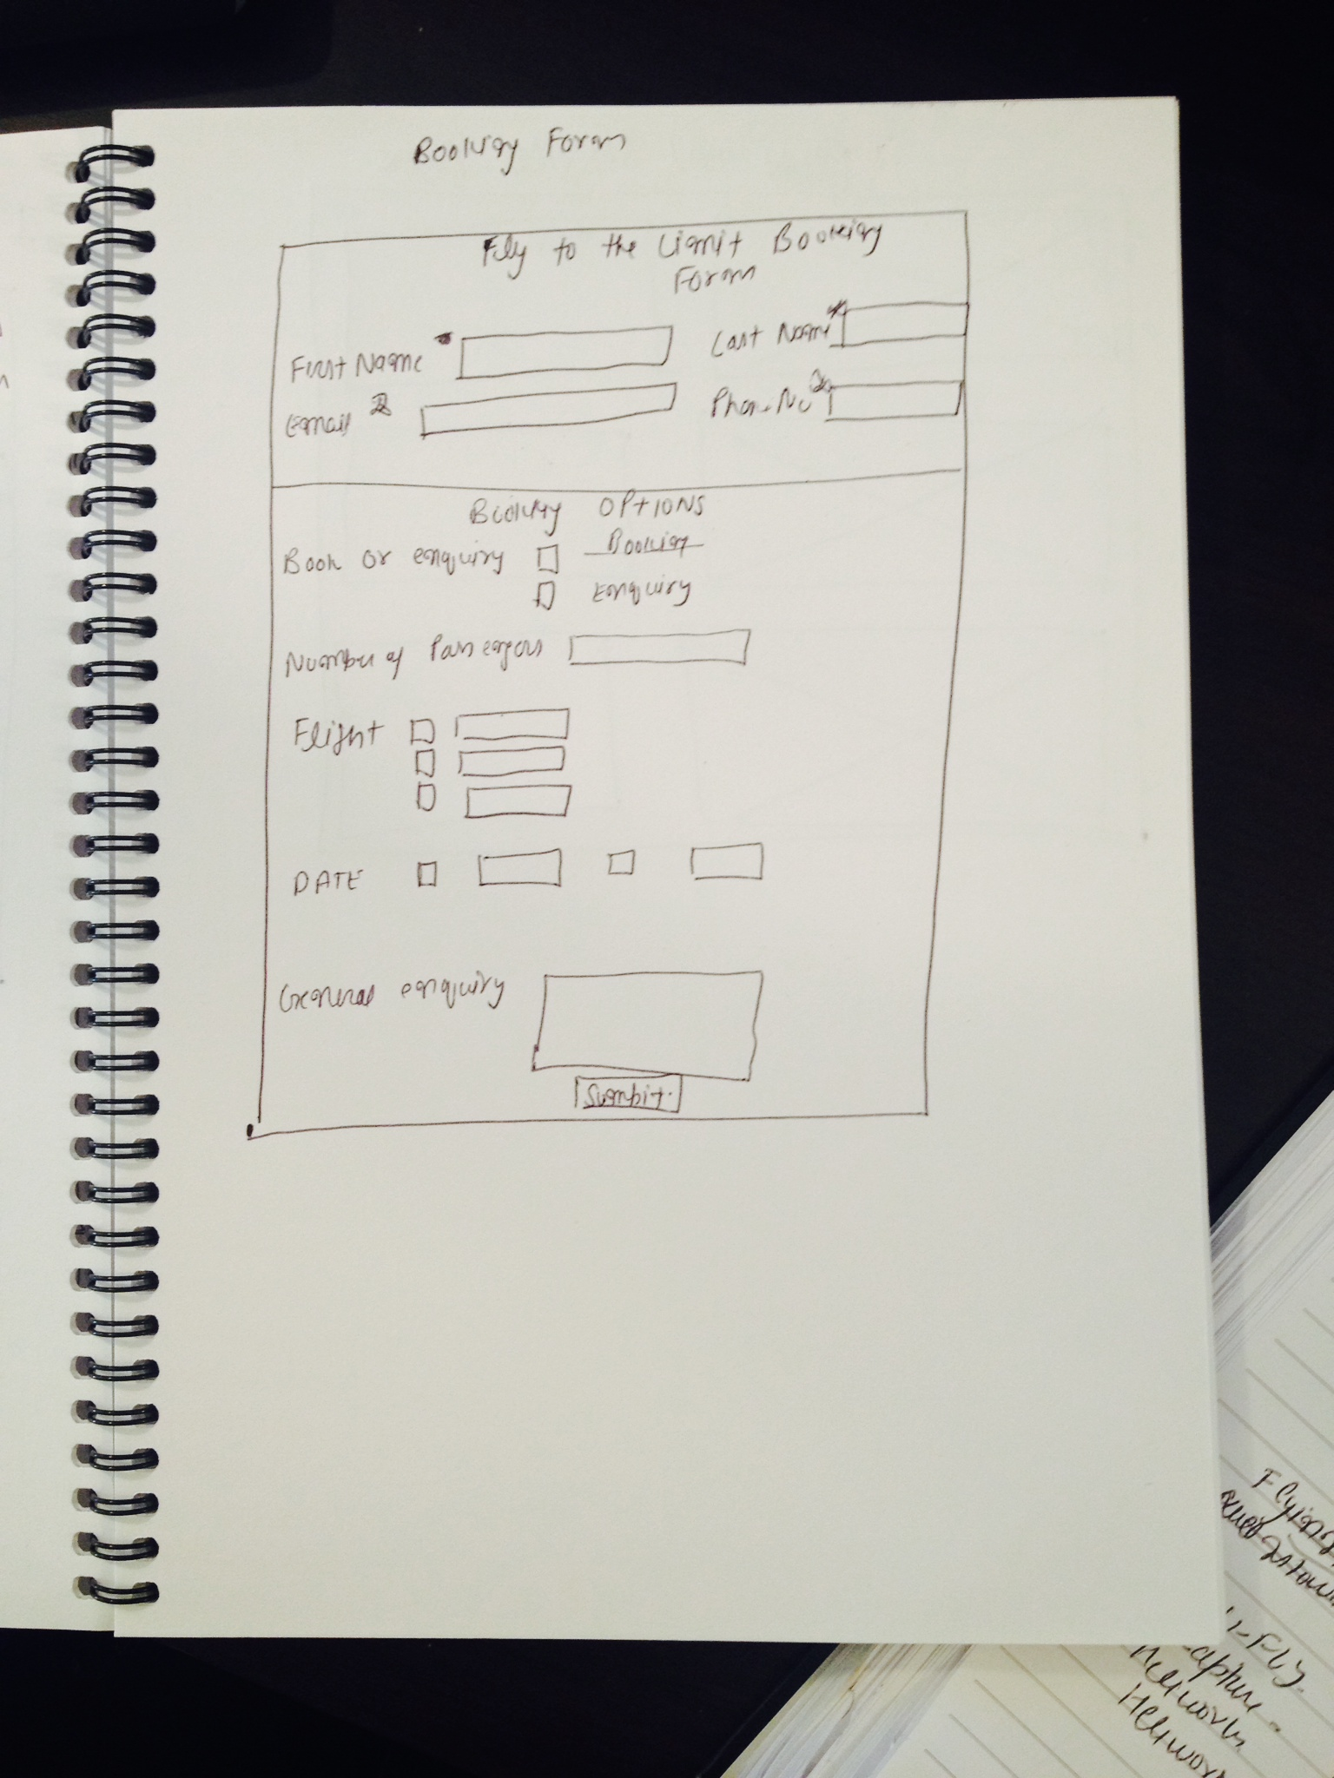
Design Brainstorming
Home Page design
Our Gallery and it’s Pop up
Booking Form
Contact Us page design

Slide 12
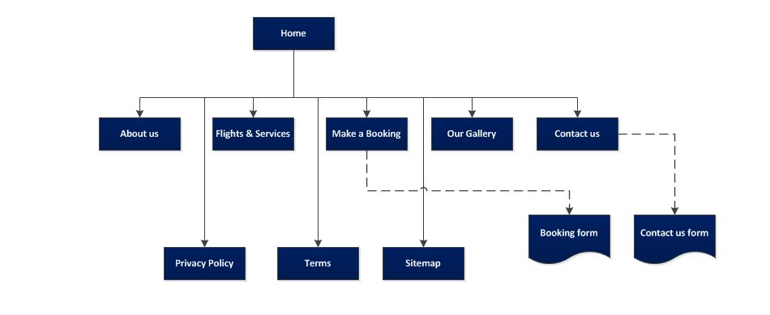
Sitemap

Slide 13
Website Designs
www.flytothelimit.co.nz

Slide 14
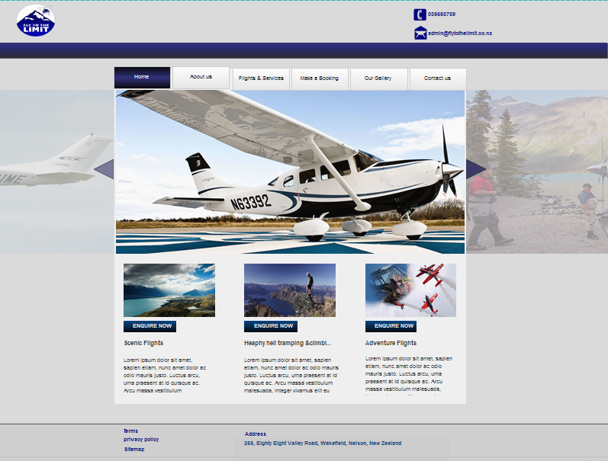
Site Layout 1
Web Design
Click here to subscribe our Newsletter

Slide 15
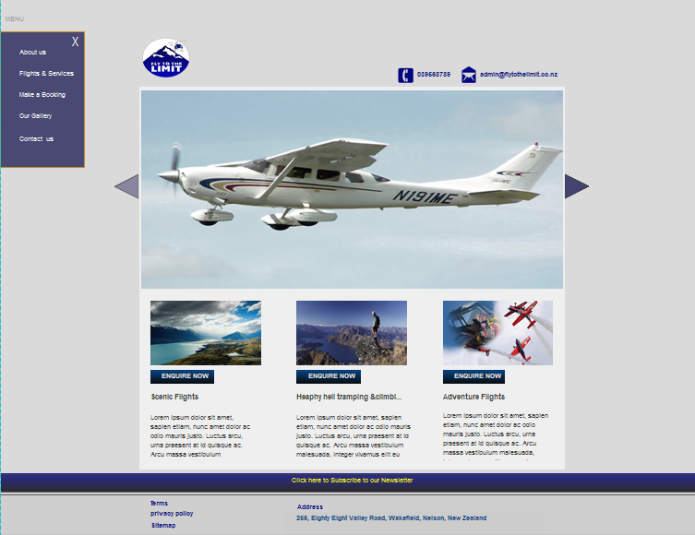
Site Layout 2
Web Design

Slide 16
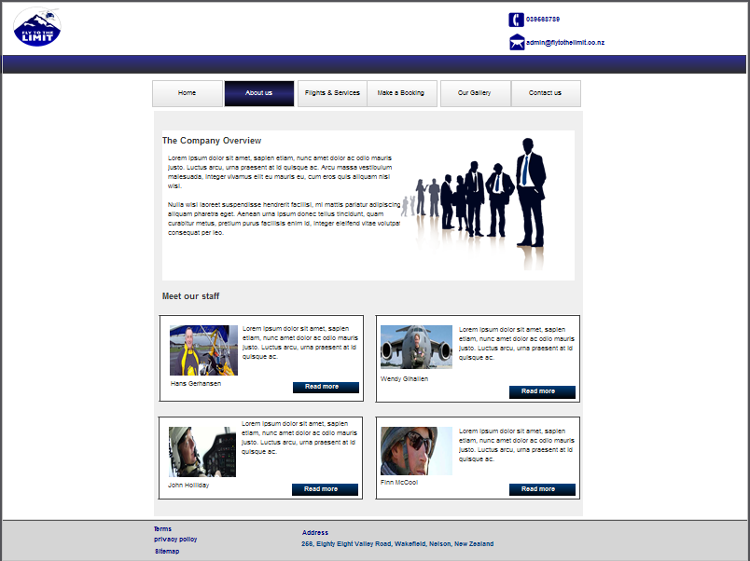
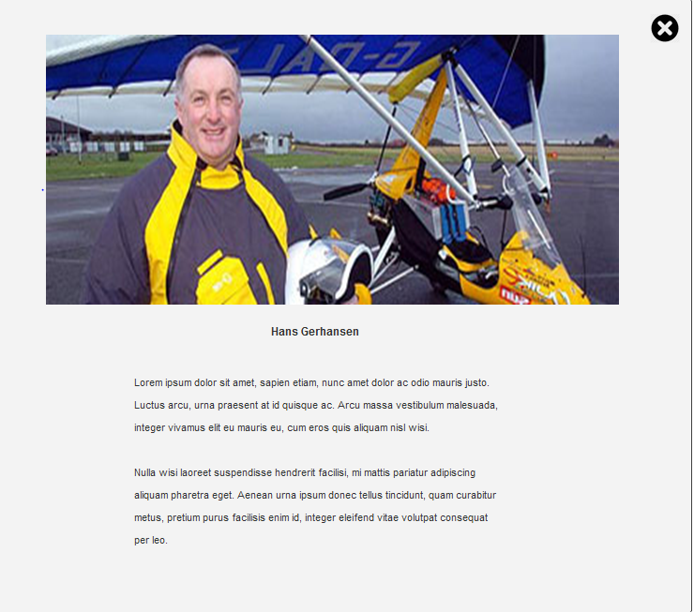
Web Design
About us
Meet our staff Pop-Up
Login | Register
Click here to subscribe our Newsletter

Slide 17
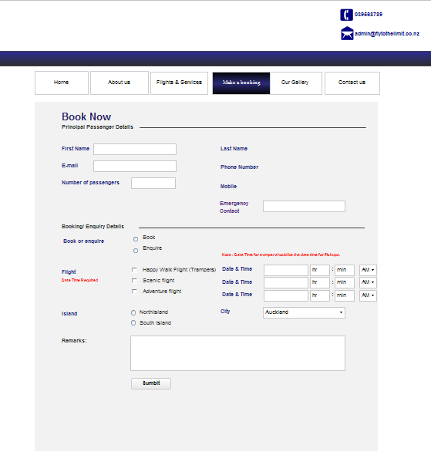
Booking Form
Web Design
Click here to subscribe our Newsletter

Slide 18
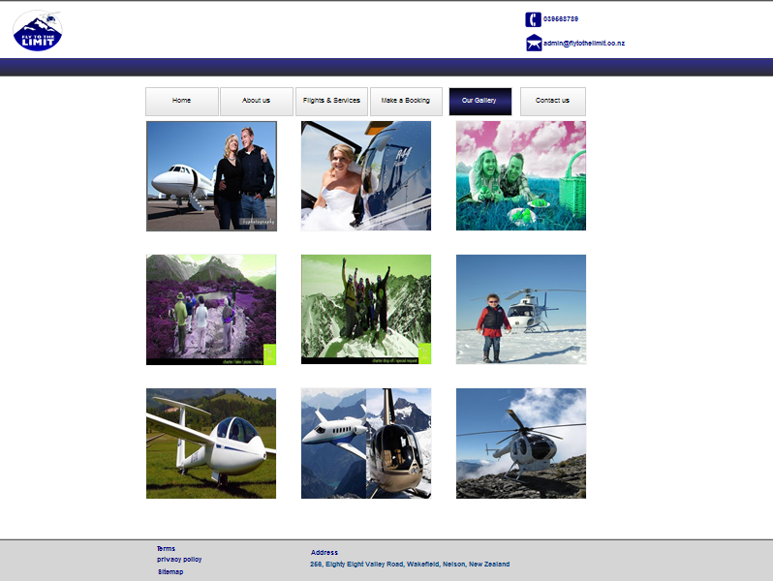
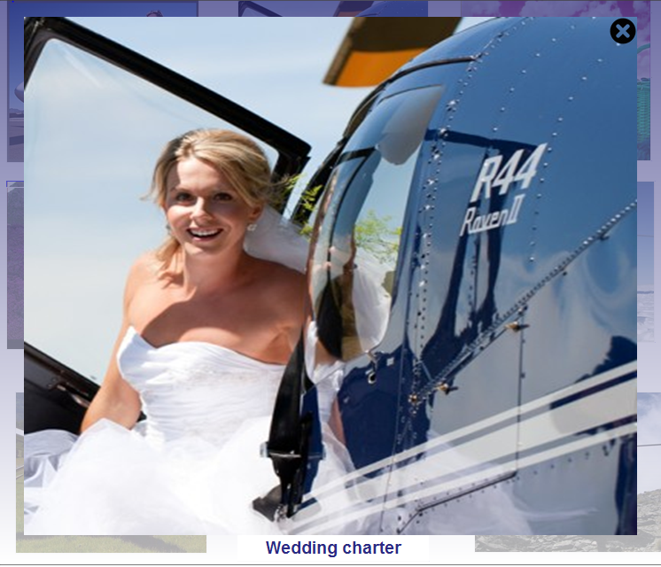
Web Design
Our Gallery
Our Gallery Pop pop-up
Click here to subscribe our Newsletter

Slide 19
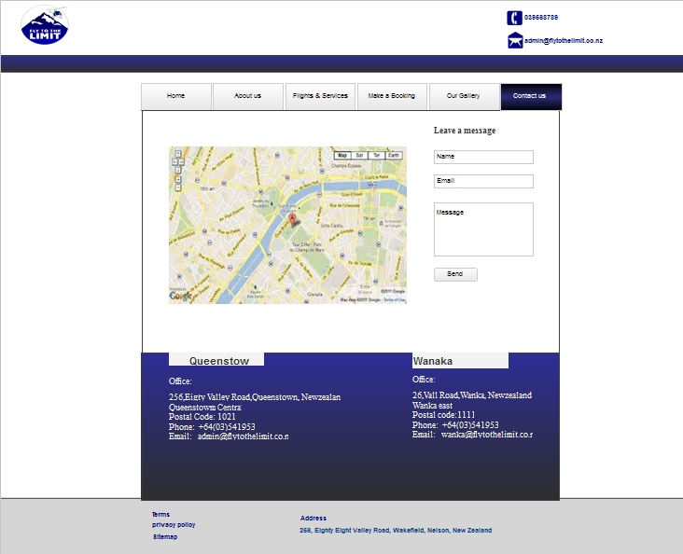
Web Design
Contact us
Click here to subscribe our Newsletter

Slide 20
Development Plan
www.flytothelimit.co.nz

Slide 21
Development Plan
Development Tasks | Requirement Brief | Testing Requirements | Time Allocation
Site Layout
Main Menu Header Footer | Main menu navigation buttons to be fixed for all pages. Logo link in header. Terms, Privacy Policy and Address links | Color change to blue on button selection and cursor pointer on mouse over. Logo link to direct to home page. Cursor pointer on logo mouse over. Cursor pointer on all links mouse over in footer. | 1 day
Home Page
Image Slider Flight Sections Flight Info Pop-up | Slider navigation buttons Enquire now links for each content section | Slider arrows change to the next /previous photo Enquire Now links direct to the booking form Cursor pointer on all links | 1 day
About Us Page
Company Overview Meet Our Staff Section Staff Info Pop-up | Content for staff & company profiles Read more links for staff Staff info popups for each staff with photo | Read more links direct to staff pop ups. Cursor pointer on all links. Pop ups with close option | 1 day
Flights & Services Page
Flights & Services Sections Info Pop-up | Content Info popups with book now links | Clickable images, link to info pop ups. Cursor pointer on all links. Pop ups with book now link options. | 1 day
Our Gallery Page
Image Gallery Enlarge View Pop-up | Content (Mainly Images) Tiled style Enlarge view pop up for all images | Clickable images, link to enlarge view pop ups. | 1 day

Slide 22
Development Plan
Development Tasks | Requirement Brief | Testing Requirements | Time Allocation
Make a booking- Form
Principal Passenger Details Booking/Enquiry Details | Required Information First name, Last Name, Email, Emergency Contact. Number of Passengers (default =1) Book/Enquire Radio buttons Flight type: Date & Time Required for selection Location information (Island and city) Optional Remarks text area. Submit button | Required message to be shown on empty required fields. Submit button to be enabled once required fields are not blank Check valid input type for email address, numbers and text. Time fields to be validated for min max values. Success message to be shown on form submission. | 3 days
Contact Us Form
Leave a message form Google Map per office location | Name and Email Required Optional message text-area Send message button | Required message to be shown on empty required fields. Send button to be enabled once required fields are not blank Check valid email address. Success message to be shown on form submission. Google map to change on click of different address city link. | 1 day
Content
To be Provided by client | To be Provided by client | To be Provided by client | N/A

Slide 23

Thank you for the opportunity. Please feel free to contact me to clarify any queries.
5 Kingsland, Auckland
021-98116767
me@mwebie.co.nz

